Slide 1

Bangladesh Army University Of Science And Technology (BAUST)
Department of Computer Science and Engineering (CSE)
Course Title: Software Development Project II
Course Code: CSE 3100
Smart Grocery Organizer
Submitted by: | Submitted to:
Mustahsan Atif | Munira Akter Mou
 | Lecturer
ID: 0802320205101023 | Maskur Al Shal Sabil
 | Lecturer

Slide 2
Project Overview
Android application designed to simplify grocery management
Helps users track items, quantities, and expiry dates
Get recipe suggestions based on their available groceries
View analytics to know dietary habits

Slide 3




Technology Stack
Languages: Kotlin (primary), Java (secondary)
IDE: Android Studio Narwhal 4
Build System: Gradle
AndroidX & Jetpack Libraries: ViewModel, LiveData, Room
Design: Material Design Components

Slide 4
Key Features
Add, update, and categorize grocery items
Track expiry dates with notification reminders
Sort and Search functionalities
Recipe suggestions based on grocery listing
Analytics Dashboard for shopping habits

Slide 5
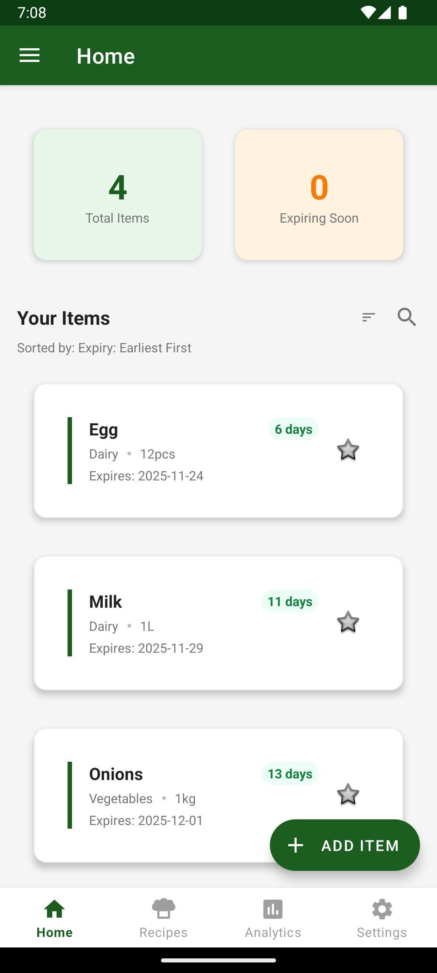
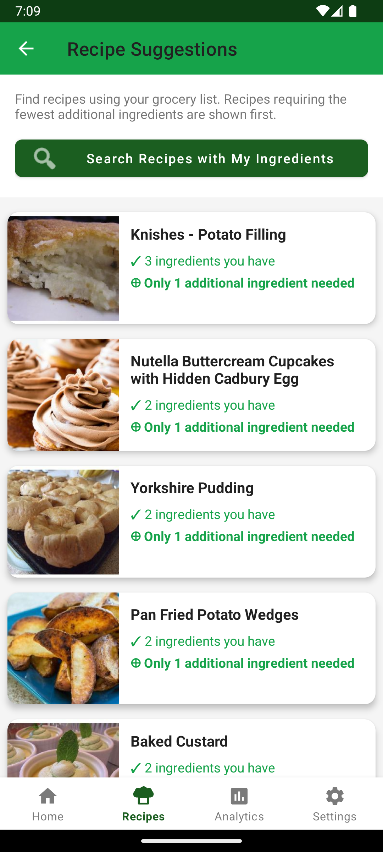
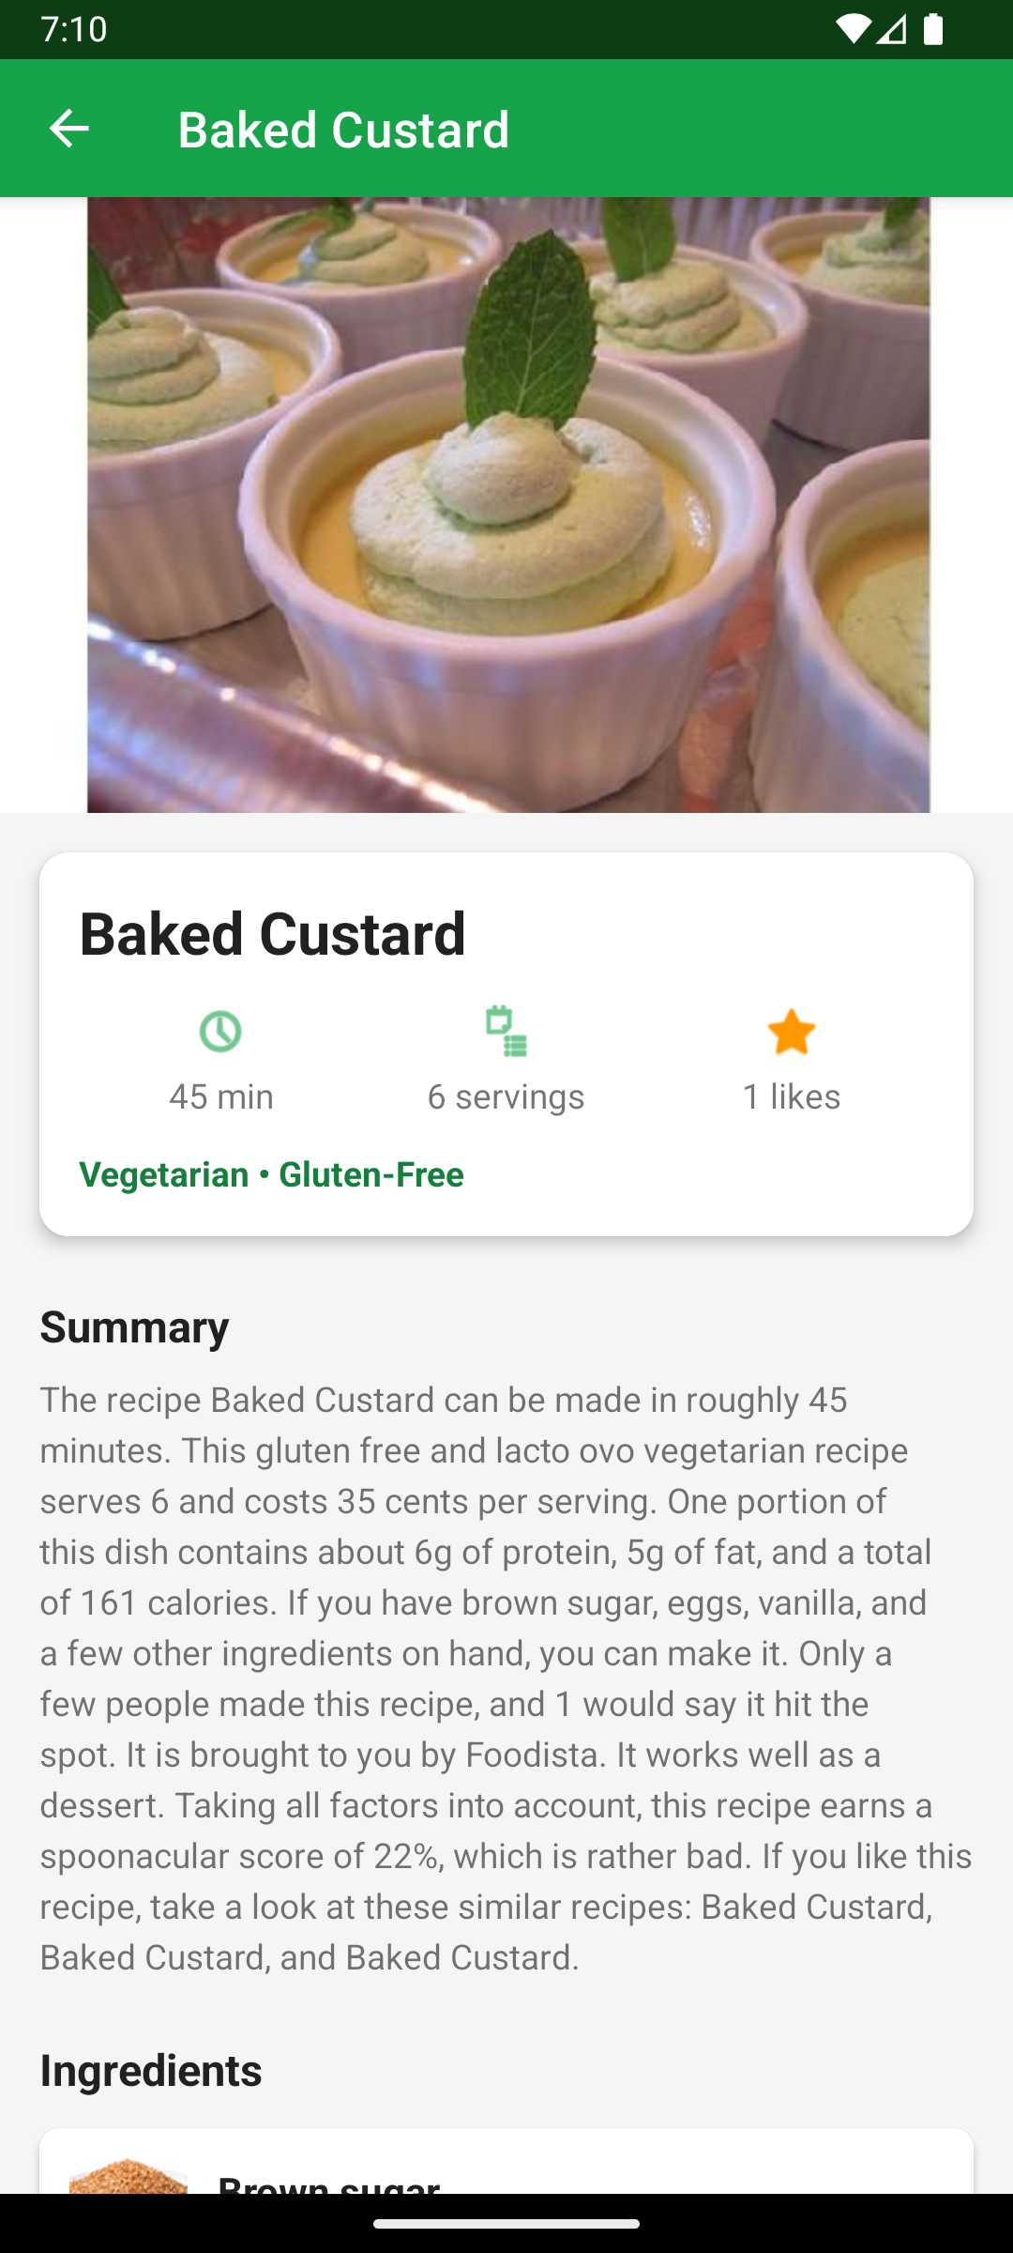
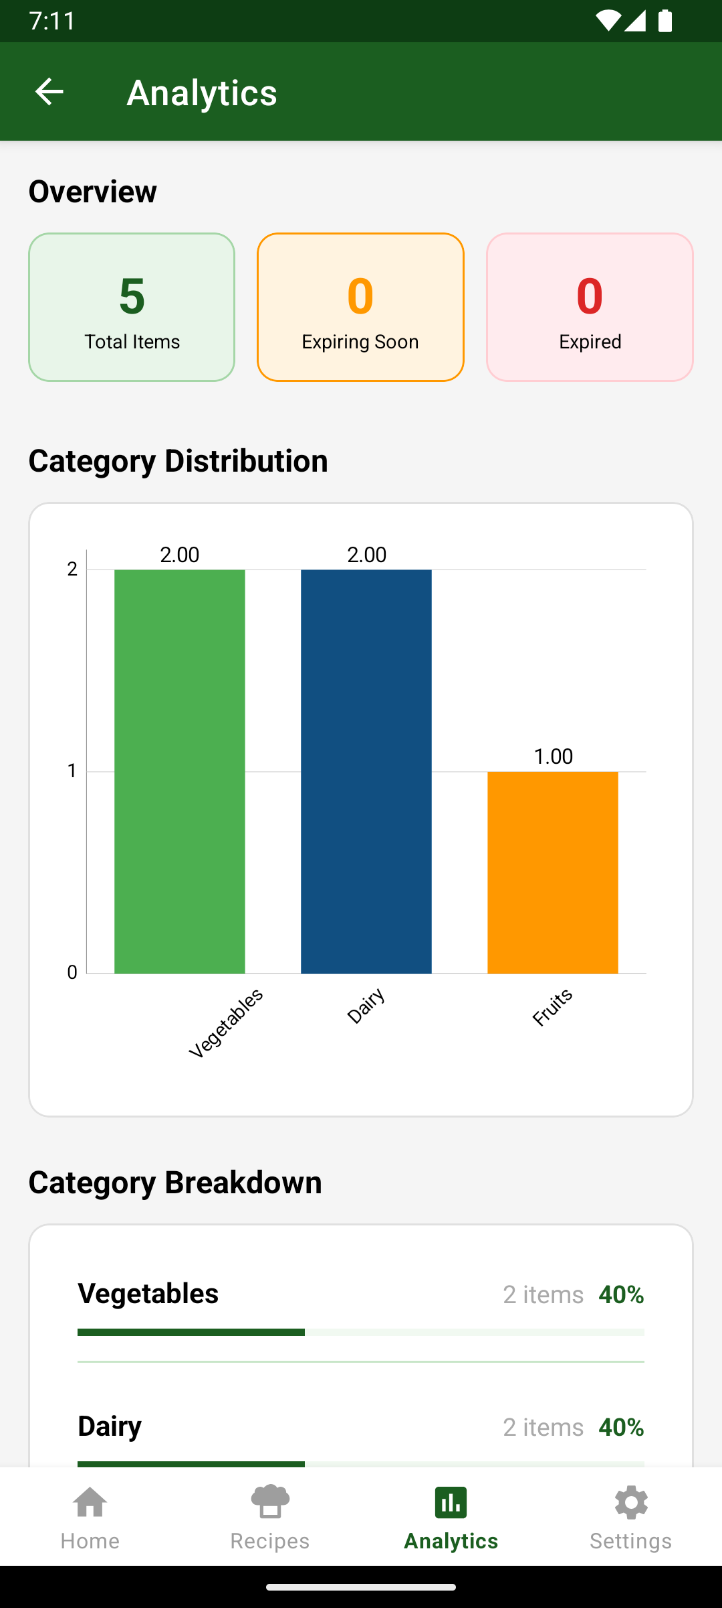

Slide 6
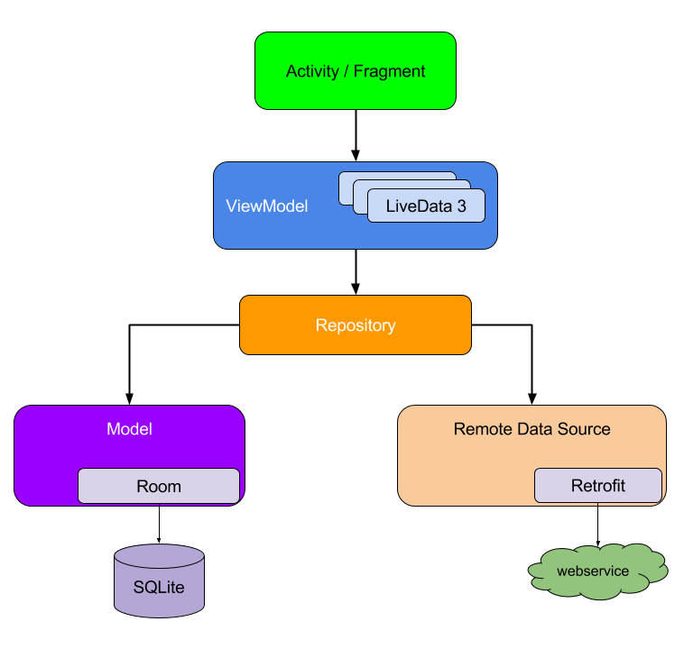
Project Architecture
Architecture Pattern: MVVM (Model–View–ViewModel)
UI Layer: Activities/Fragments and XML layouts
Data Layer: Room database, DAO interfaces
Domain Layer: Repository pattern for data abstraction

Slide 7
Future Enhancements
Cloud integration for remote data sync
Enhanced user analytics and reporting
Multi-language support
Multi-device support
Barcode scanning for quick item entry
AI-based smart suggestions for grocery planning

Slide 8
Conclusion
Built a clean, scalable Android app with a focus on performance and usability.
Used Kotlin, Java, and Jetpack components for maintainable and stable code.
Set up a solid foundation for future growth and new features.

Slide 9
Thank You

